Slide 1
Deep Learning with TensorFlow and Spark using GPUs and Docker Containers
Thomas Phelan
Chief Architect, BlueData
@tapbluedata
Nanda Vijaydev
Director of Solutions, BlueData
@nandavijaydev

Slide 2
Agenda
Big Data, Machine Learning, and Deep Learning
Deep Learning with GPUs and Docker Containers
Example with TensorFlow + Spark: Image Classification
Distributed TensorFlow + Spark with GPUs and Docker
Key Takeaways and Recommendations
Q & A

Slide 3
Big Data
Big Data refers to data sets that are so voluminous and complex that traditional
data-processing application software are inadequate to deal with them.
Characterized by: volume, variety, velocity
Source: https://en.wikipedia.org/wiki/Big_Data

Slide 4
Machine Learning (ML)
Machine learning is a field of computer science that uses statistical techniques to give computer systems the ability to "learn"
(i.e., progressively improve performance on a specific task) with data.
Source: https://en.wikipedia.org/wiki/machine_learning

Slide 5
Deep Learning (DL)
Deep learning is part of a broader
family of machine learning methods
based on learning data representations, as opposed to task-specific algorithms.
Source: https://en.wikipedia.org/wiki/deep_learning

Slide 6
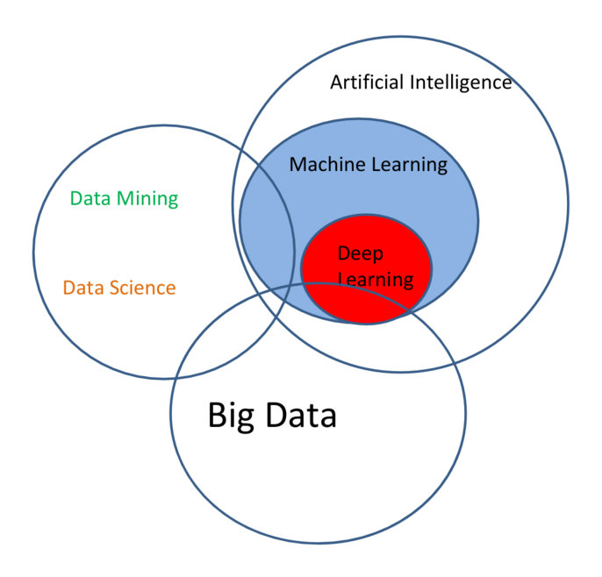
Big Data, Data Science, and ML / DL
Source: http://innovaleur.com/the-data-science-puzzle-explained

Slide 7
Popular Deep Learning Frameworks

Slide 8
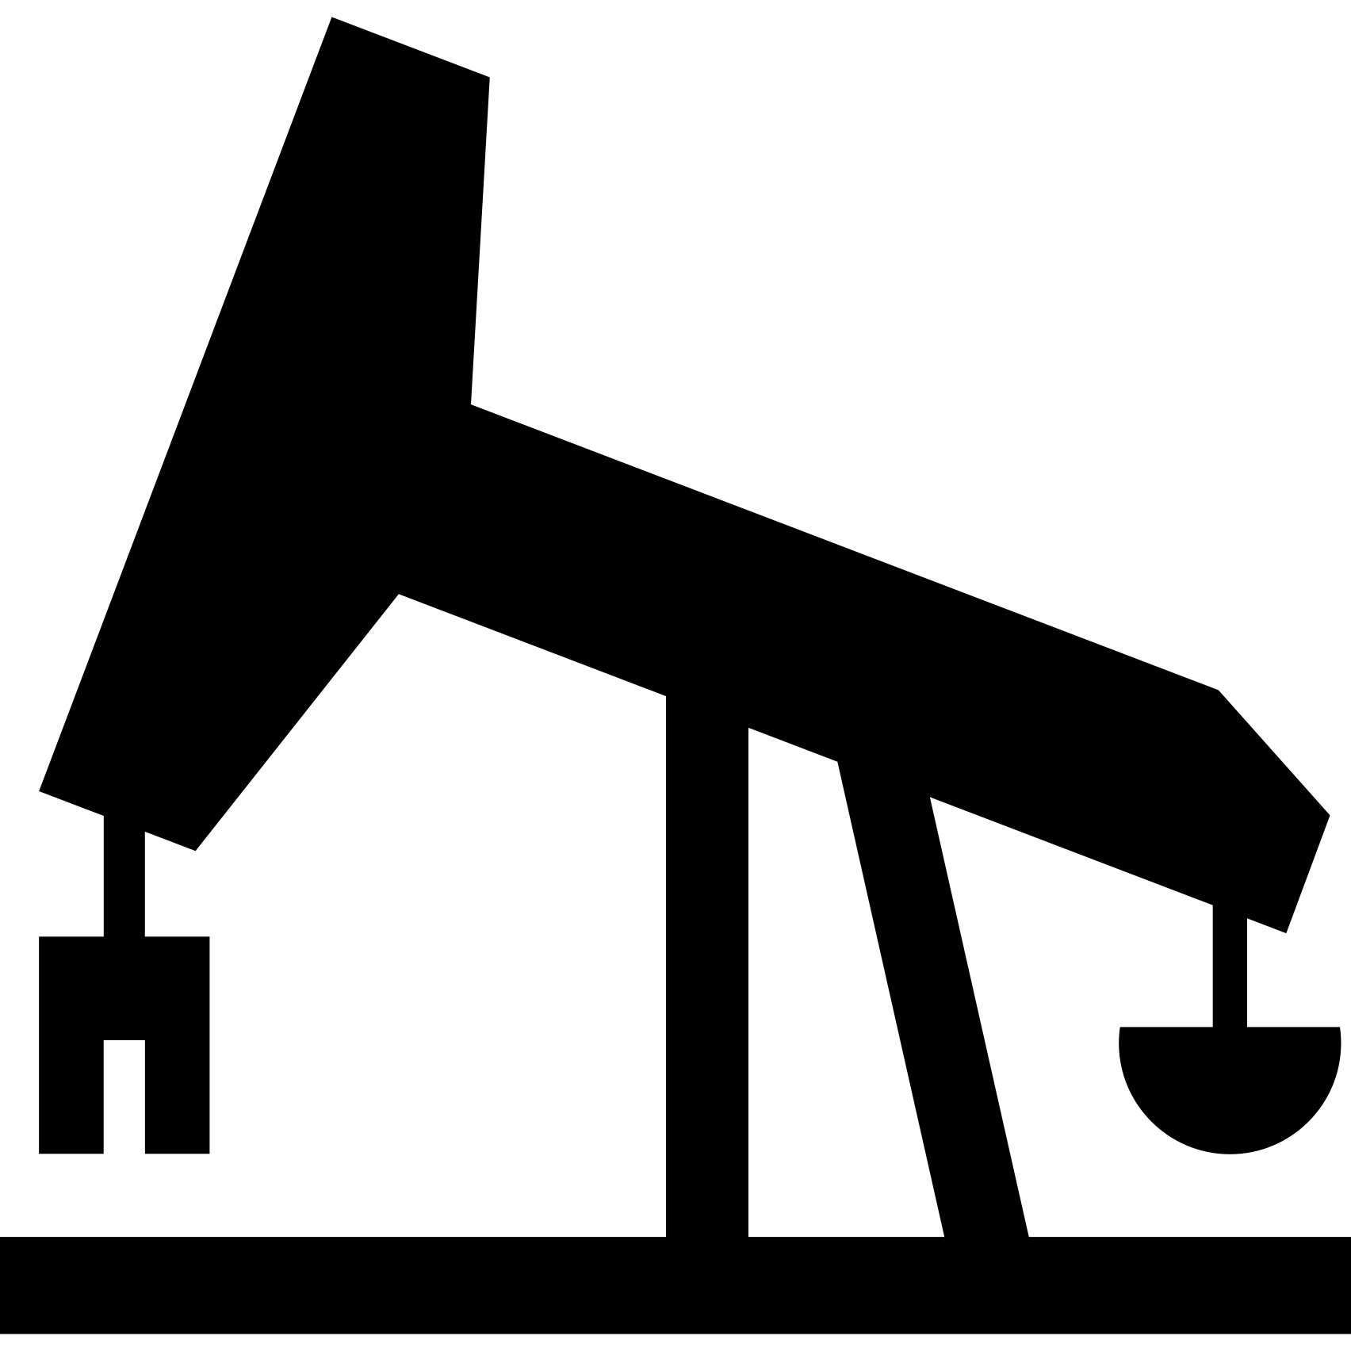
Enterprise Deep Learning Use Cases
Fraud Detection
Medical Diagnosis
Prediction
Credit Cards
Car Loans
Detection / Prediction of Cancer, Alzheimer’s, Pneumonia
Weather Forecast Gas & Oil Location
Buyer / Trader Action

Slide 9
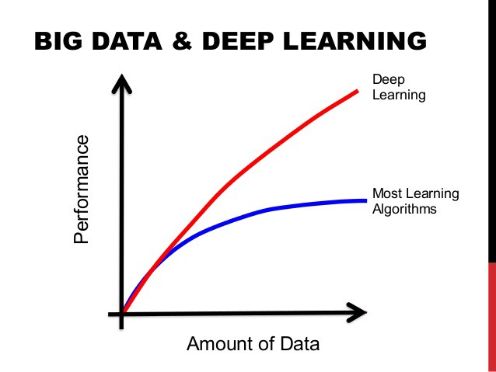
Requirements for Deep Learning
Deep learning uses general learning algorithms
The algorithms need to build the layers of an artificial neural network
Training data
Processing this training data requires lots of computation
Convolutional NN -> Matrix multiplications
Source: https://towardsdatascience.com/7-practical-deep-learning-tips-97a9f514100e

Slide 10
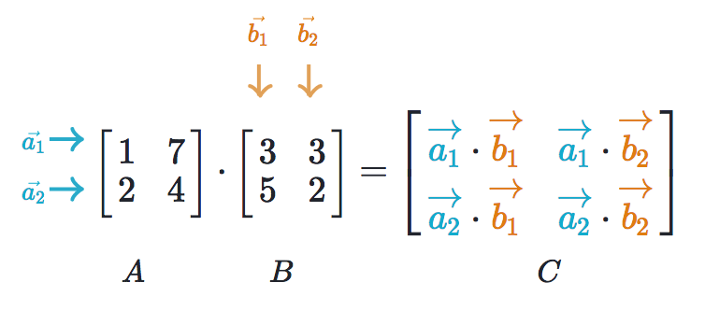
Matrix Multiplication
Source: https://www.khanacademy.org/math/precalculus/precalc-matrices/multiplying-matrices-by-matrices/a/multiplying-matrices

Slide 11
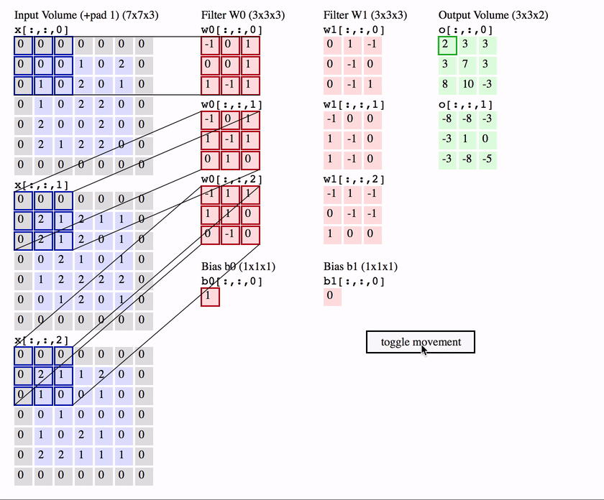
Convolutional Neural Network
Source: https://medium.com/@phidaouss/convolutional-neural-networks-cnn-or-convnets-d7c688b0a207

Slide 12
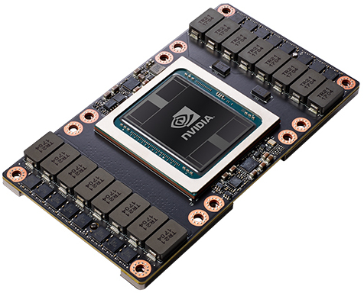
Requirements for Deep Learning
Q: What hardware is commonly used for deep learning and matrix multiplications?
A: Graphics Processing Units (aka GPUs)

Slide 13
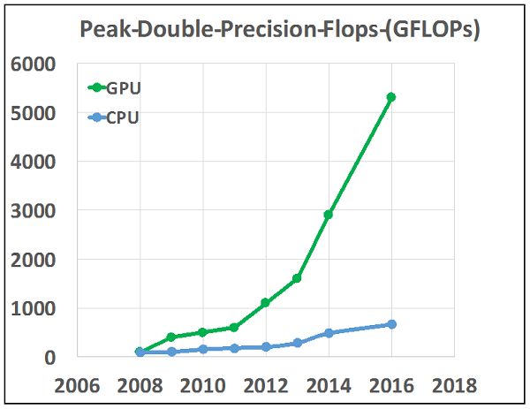
Performance of CPUs vs. GPUs
Source: https://www.hpcwire.com/2016/08/23/2016-important-year-hpc-two-decades

Slide 14
NVIDIA GPUs and CUDA
NVIDIA is the most common manufacturer of GPUs
CUDA is the software that allows applications to access the NVIDIA GPU hardware
CUDA library or toolkit
CUDA kernel device driver
GPU-hardware specific

Slide 15
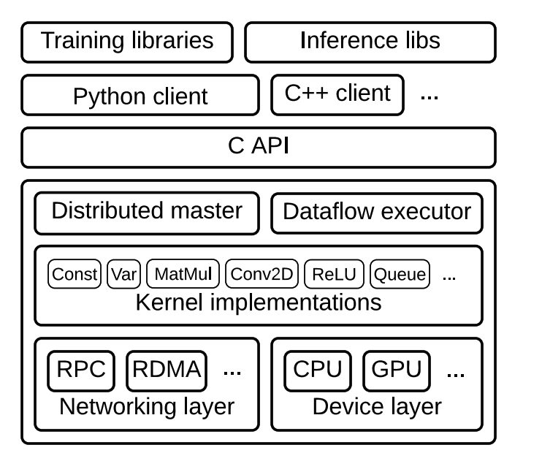
TensorFlow Architecture
Source: www.tensorflow.org/extend/architecture

Slide 16
TensorFlow with Spark
Spark Driver
Spark Executor
Spark Executor
Spark Executor
Parameter Server
TensorFlow Algo
TensorFlow Algo
TensorFlow Core
TensorFlow Core
TensorFlow Core
GPU
GPU
GPU
HDFS Data

Slide 17
Docker Containers
Docker is a computer program that
performs operating-system-level virtualization also known as containerization.
Containerization allows the existence of multiple isolated user-space instances.
Source: https://en.wikipedia.org/wiki/docker_(software)

Slide 18
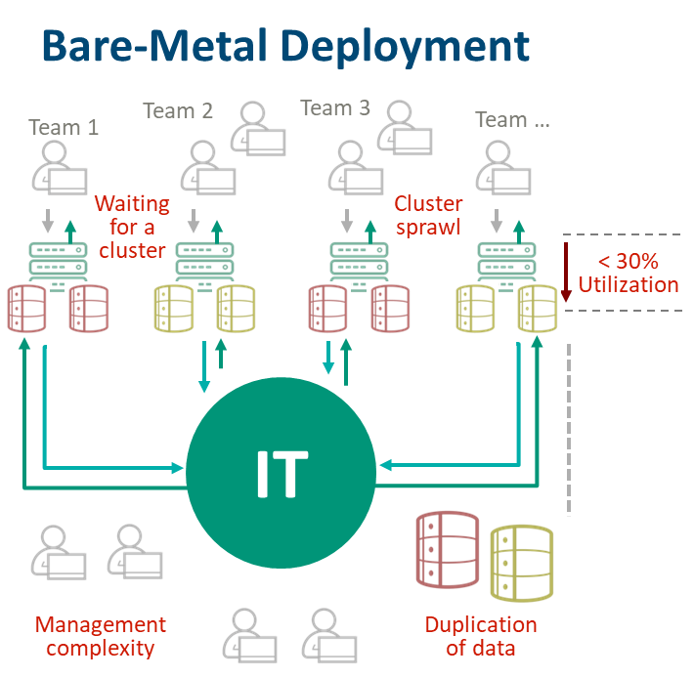
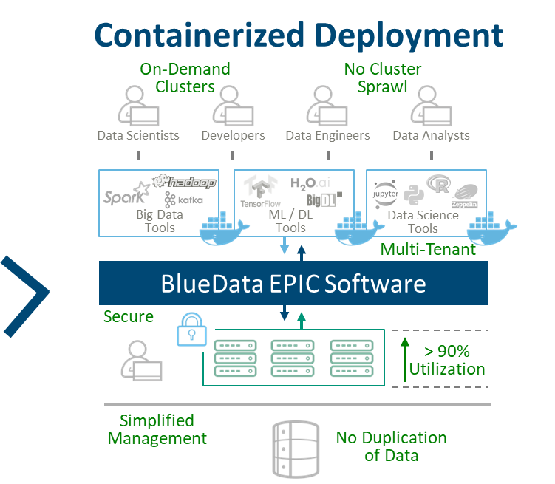
Big Data / ML / DL Deployment Models

Slide 19
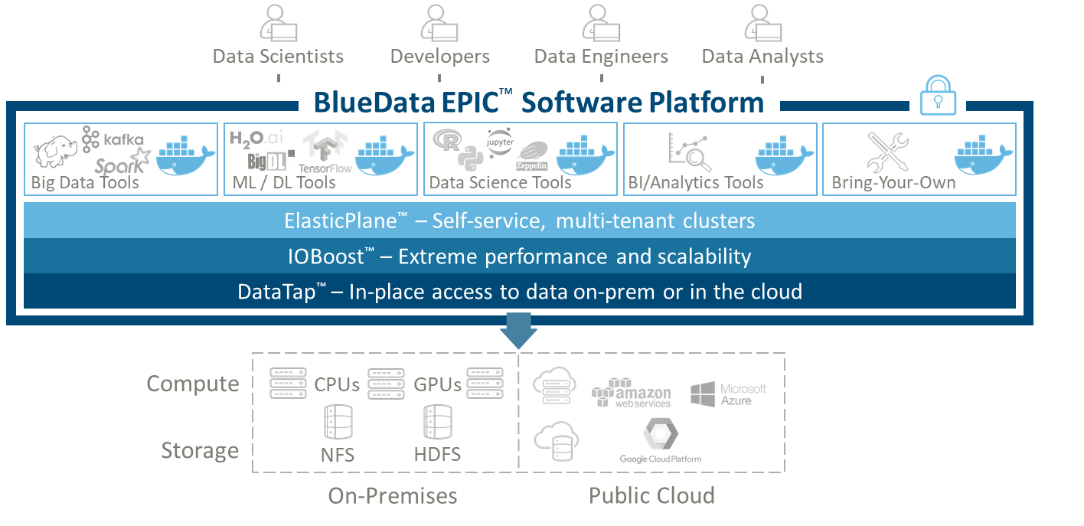
Running Big Data / ML / DL on Docker

Slide 20
TensorFlow with Spark on Docker
Docker Containers
Spark Driver
Spark Executor
Spark Executor
Spark Executor
Parameter Server
TensorFlow Algo
TensorFlow Algo
TensorFlow Core
TensorFlow Core
TensorFlow Core
GPU
GPU
GPU
HDFS Data

Slide 21
TensorFlow with Spark on BlueData
HOST 1
HOST 2
Spark Driver
Spark Driver
Spark Executor
Spark Executor
Spark Executor
Spark Executor
Parameter Server
TensorFlow Algo
TensorFlow Algo
Parameter Server
TensorFlow Core
TensorFlow Core
TensorFlow Core
TensorFlow Core
GPU
GPU
GPU
GPU
GPU 1
GPU 2
GPU 1
GPU 2
HDFS Data 1
HDFS Data 2

Slide 22
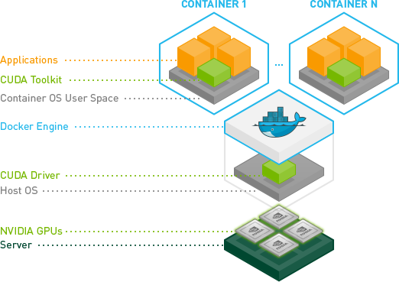
GPU Access from within a Container
Source: http://www.nvidia.com/object/docker-container.html

Slide 23
Deep Learning & Docker Containers
Deep learning (DL) applications are compute hardware intensive
They can benefit from the flexibility, agility, and resource sharing attributes of containerization
But care must be taken in how this is done, especially in a large-scale distributed environment

Slide 24
Potential DL Deployment Challenges
How to run clusters on heterogeneous host hardware
CPUs and GPUs, including multiple GPU versions
How to maximize use of expensive hardware resources
How to minimize manual operations
Automating the cluster creation and and deployment process
Creating reproducible clusters and reproducible results
Enabling on-demand provisioning and elasticity

Slide 25
DL Deployment Challenges (Cont’d)
How to support the latest versions of software
Deployment complexity and upgrades
Version compatibility
How to ensure enterprise-class security
Network, storage, user authentication, and access

Slide 26
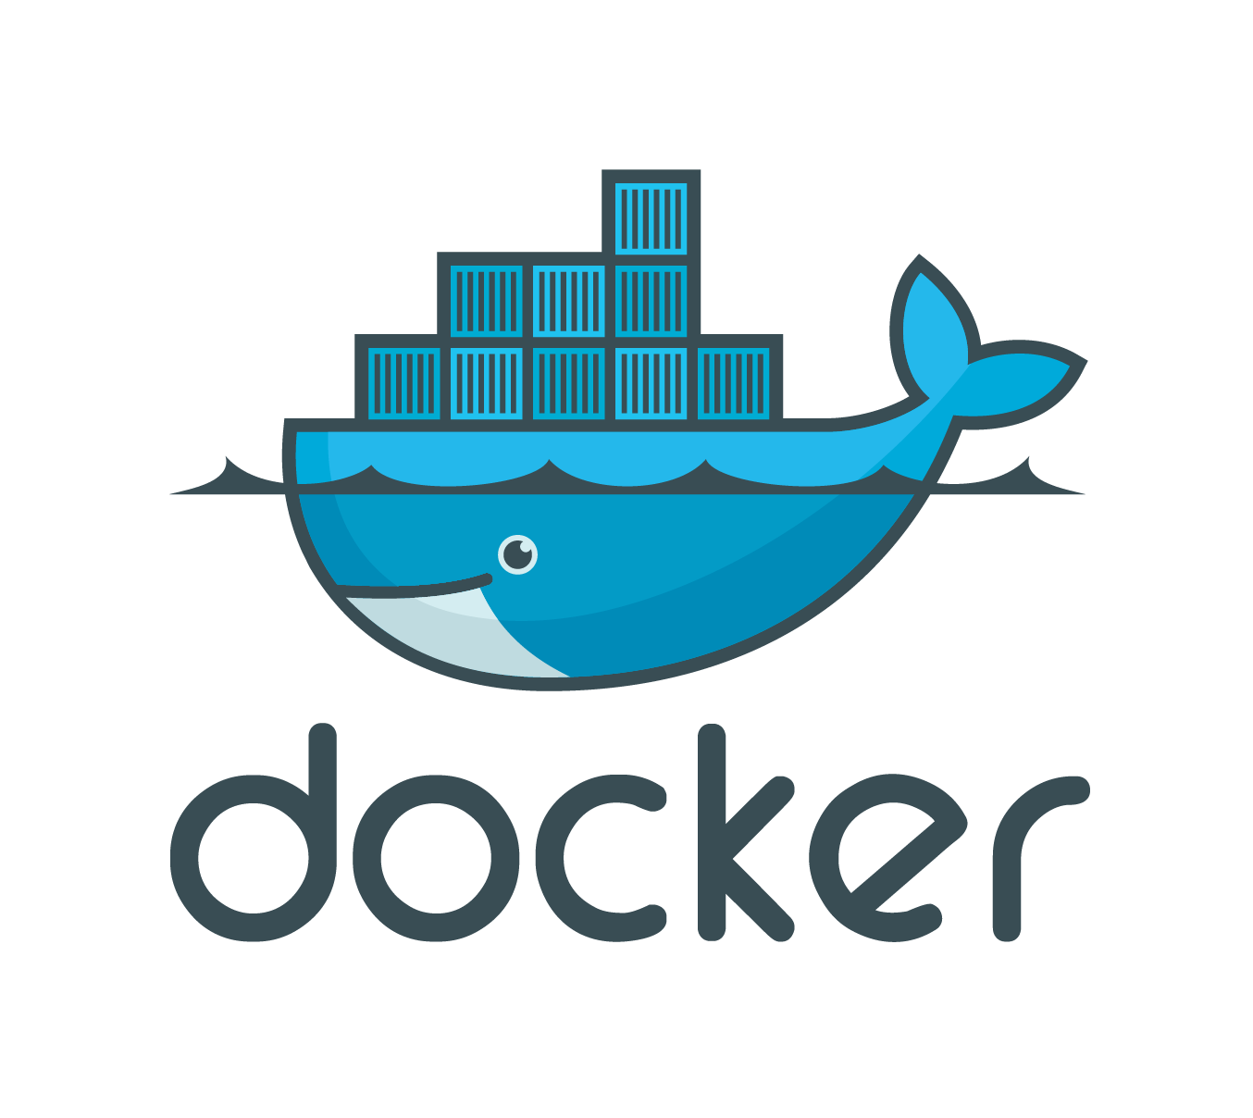
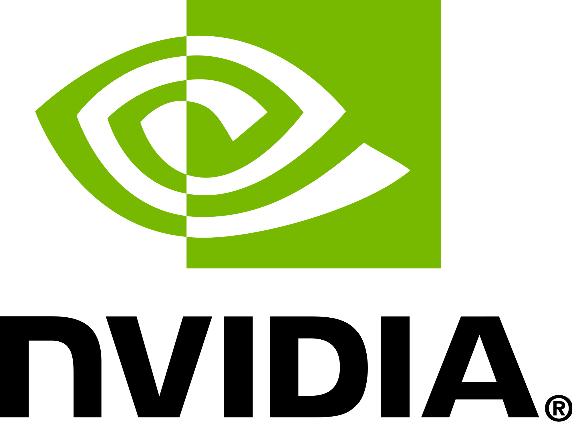
Demo Example: Image Classification
Distributed Deep Learning
with TensorFlow, Spark, GPUs, and Docker
using the BlueData EPIC Platform

Slide 27
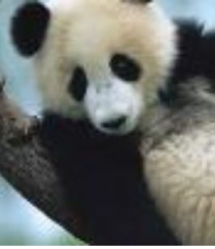
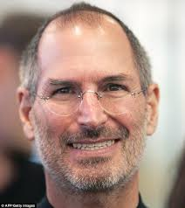
Demo
Single node, Python-based image recognition
Standard image recognition from TensorFlow website: https://www.tensorflow.org/versions/master/tutorials/image_recognition
Multi-node, PySpark-based image classification on a Spark cluster
A published example with TensorFlow, Apache Spark, Spark DL, and Python: https://medium.com/linagora-engineering/making-image-classification-simple-with-spark-deep-learning-f654a8b876b8

Slide 28
Going from Single Node to Distributed Processing
Make sure all nodes are GPU-enabled
Choose a software stack that can run distributed models
All nodes should have the necessary libraries
Consistent definition of environments across all nodes (Python venv for Tensorflow), Spark configuration (executor memory, driver memory, PySpark Python)
Flexibility to scale up and down as needed

Slide 29
Goal: Accurate Image Prediction
Classifying a test picture
Training set accuracy using a multi-class classification evaluator

Slide 30
Demo Environment Details
Multiple Docker containers (4) running Spark 2.1.1, each with 1 GPU (Tesla P100)
NVIDIA device kernel (driver version: 390.46)
NVIDIA CUDA (8.0) and cuDNN libraries, with TensorFlow (1.4)
Spark deep learning toolkit (spark.jars.packages=databricks:spark-deep-learning:0.1.0-spark2.1-s_2.11)
Anaconda Python with Image, Keras, and other libraries
Source: https://medium.com/linagora-engineering/making-image-classification-simple-with-spark-deep-learning-f654a8b876b8

Slide 31
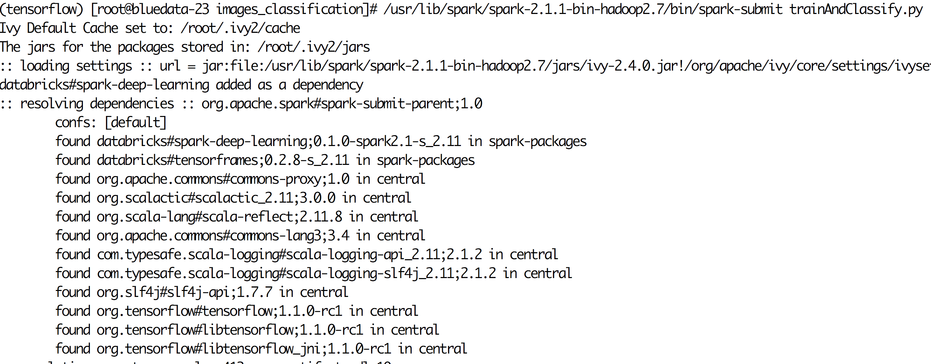
Image Classification: Spark Job
Run a PySpark job for building the model and testing in Docker containers
Spark deep learning libraries are included

Slide 32
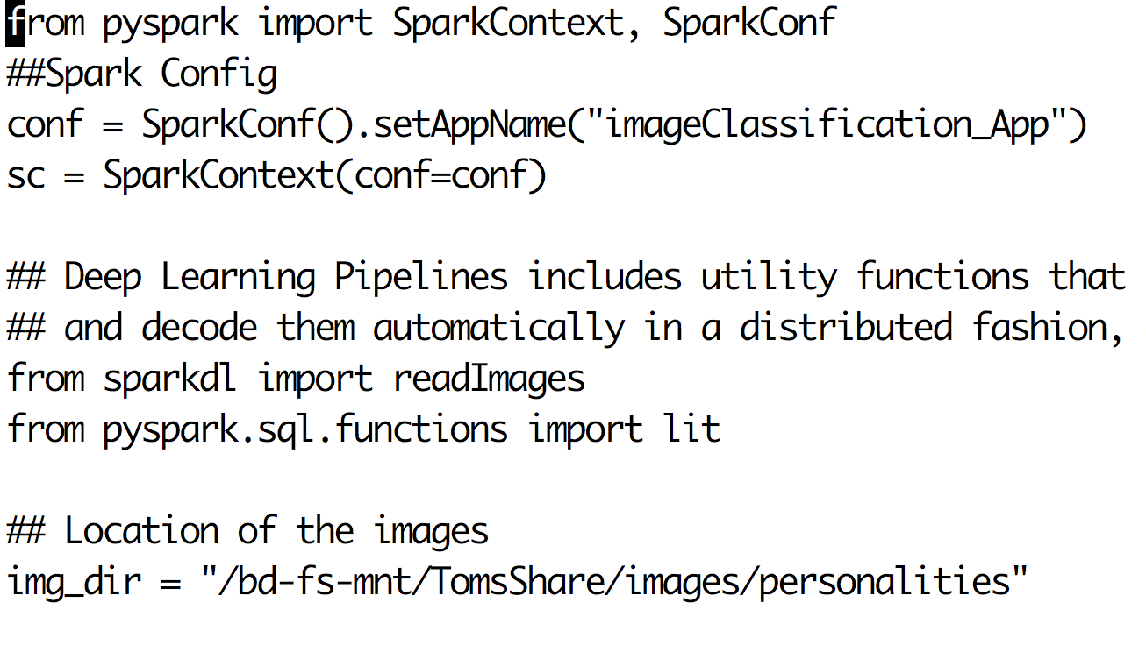
Image Classification: Spark DL
Classification runs in a Spark Context
Pipeline uses Spark deep learning framework
Images used are stored in NFS share

Slide 33
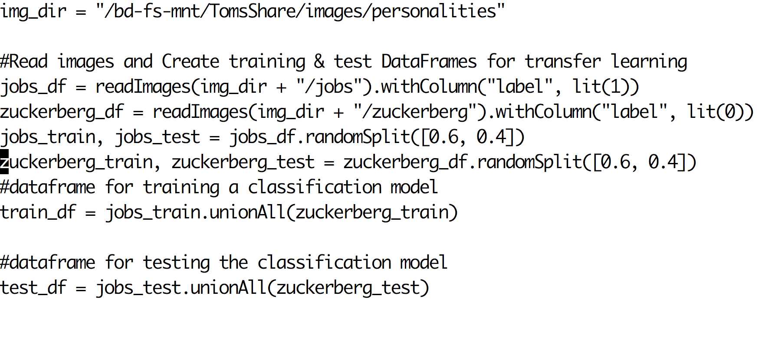
Image Classification: Test/Train Data
Create test and train dataframes with a 60/40 split

Slide 34
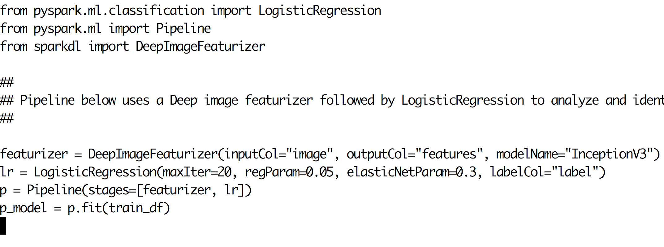
Image Classification: Model Pipeline
Model pipeline includes a Deep Image Featurizer followed by Logistic Regression
Output features
with predictions on training data

Slide 35
Challenges Encountered
Compatible NVIDIA device kernel module installation
Availability of GPUs as and when needed
Compatibility issues between various stacks (CUDA, TensorFlow, Python, and Spark)
Being able to reproduce same environment
Ability to customize parts of the stack for individual use cases

Slide 36
With BlueData, Challenges Solved
Pre-built Docker images with CUDA and automated cluster creation for the entire stack
Appropriate NVIDIA kernel module surfaced automatically to the containers
Easy access to resources required (e.g. single node, single GPU, multi-node, multi-GPU combinations)
UI, CLI, and API access (notebooks, web, SSH)
NFS mounts surfaced as local drives for sharing assets

Slide 37
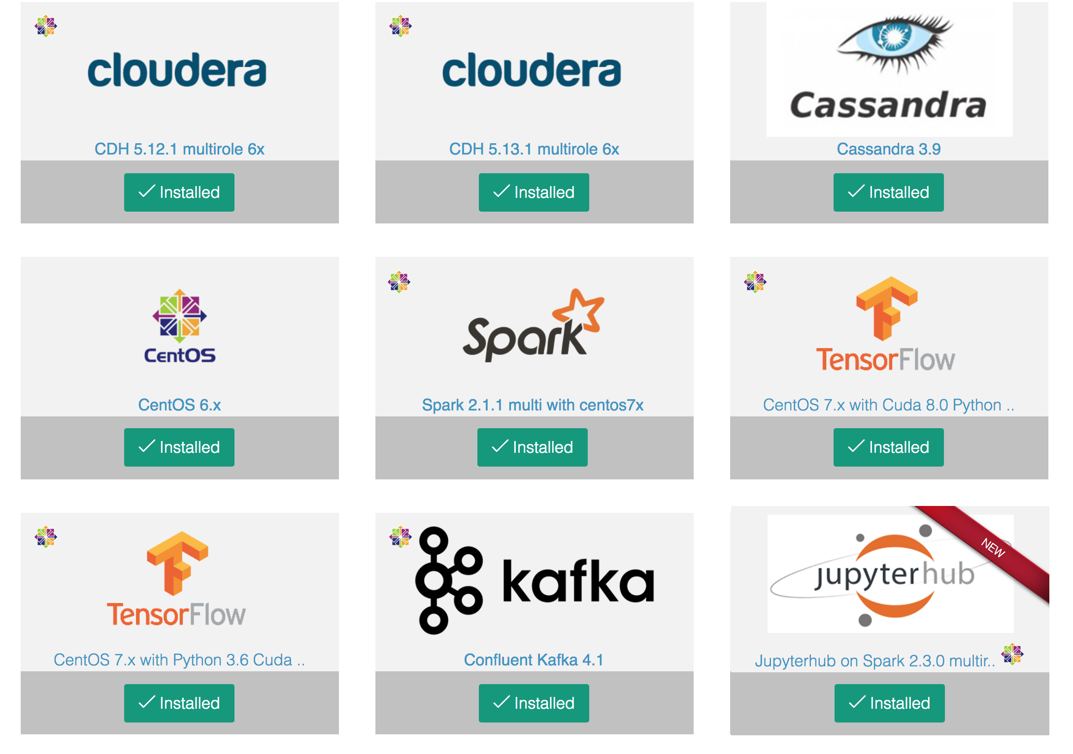
Pre-Built Images in the App Store
Docker images for multiple applications and versions
Ability to create and add new images, and save or restore tested combinations on demand

Slide 38
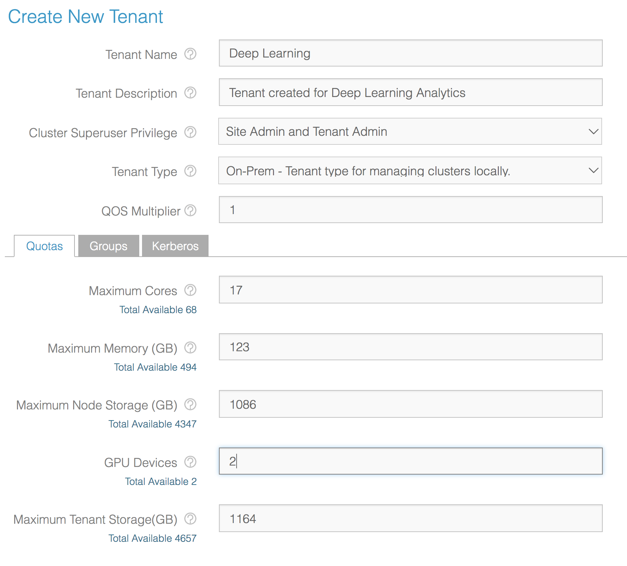
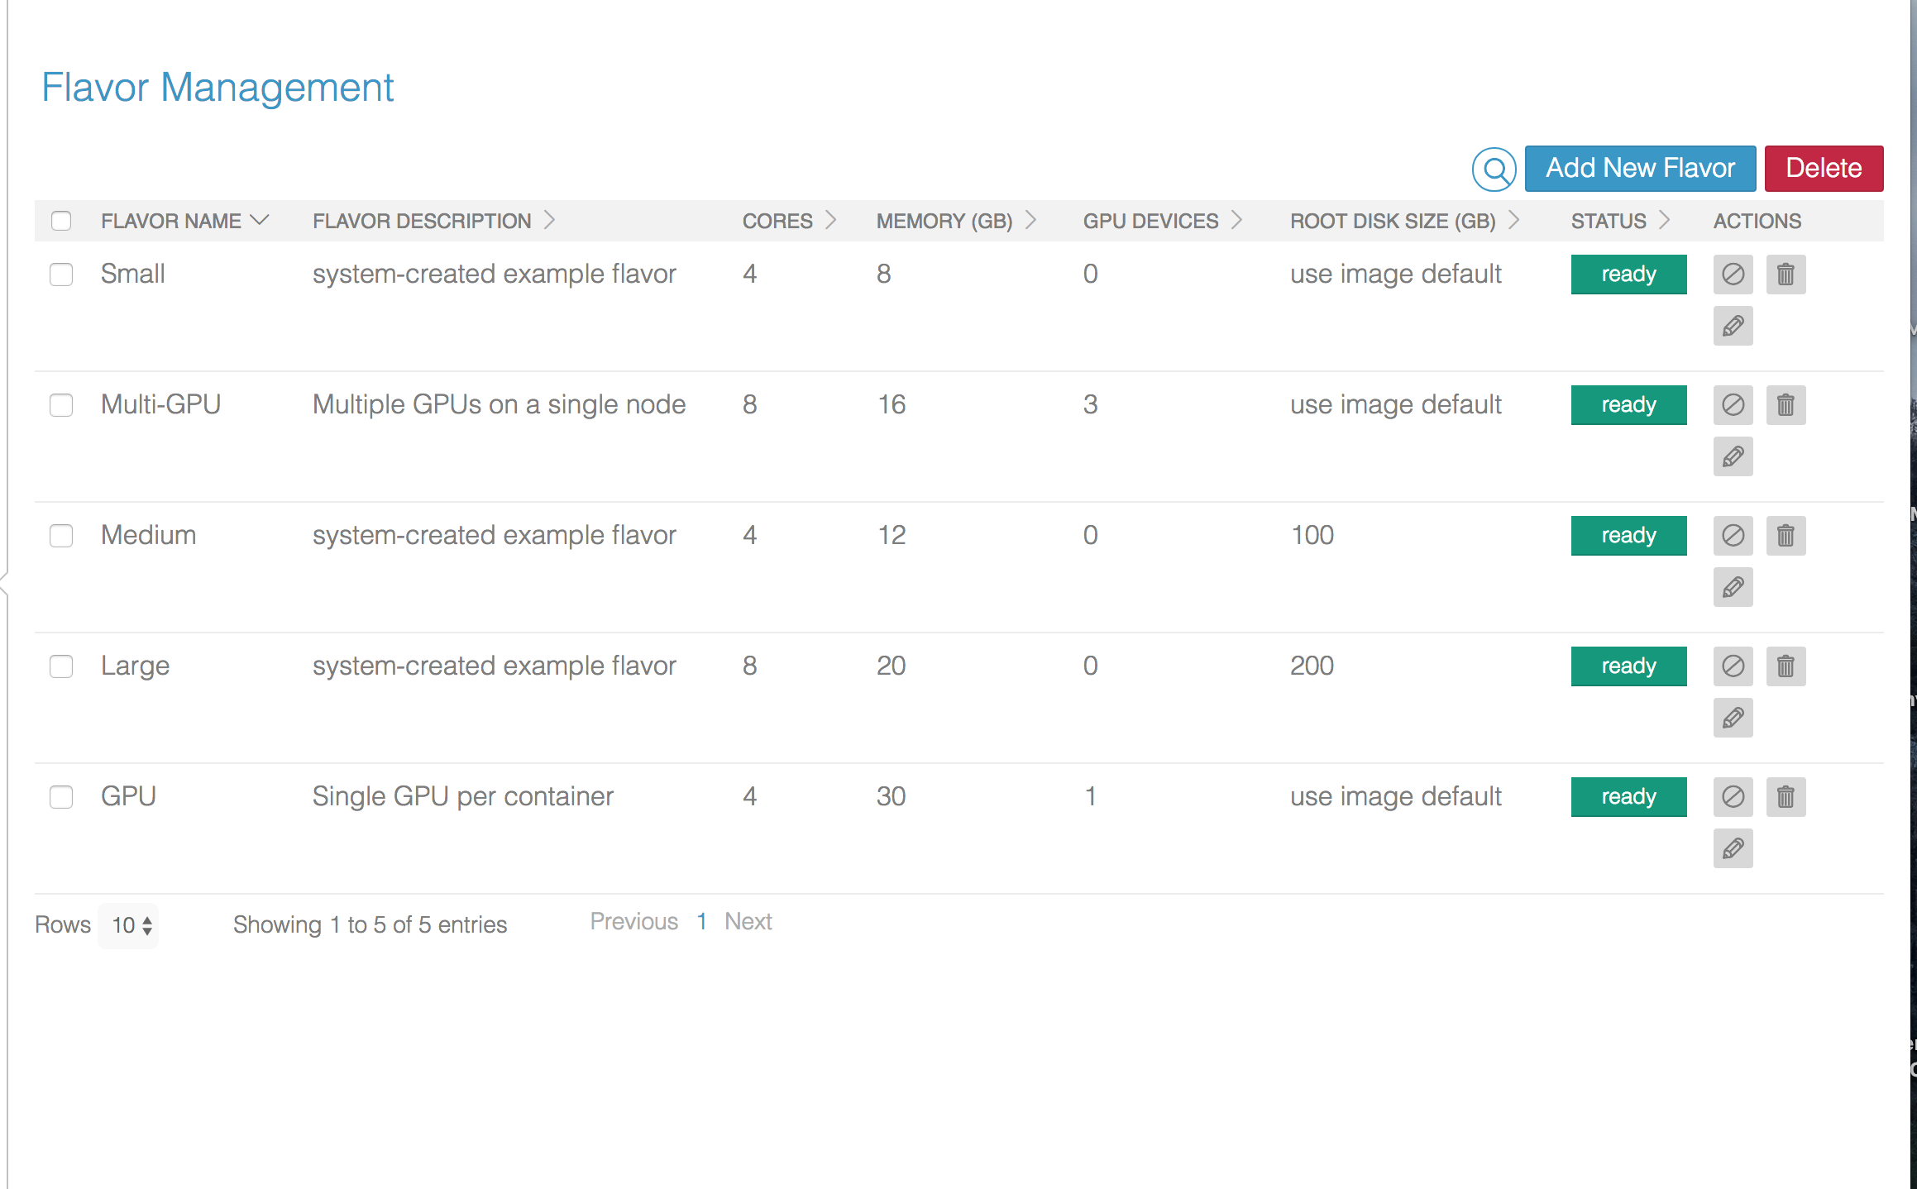
Quotas For GPU Resources
Defining flavor types used to launch Docker containers
Support for multi-tenancy and ability to define quota per tenant

Slide 39
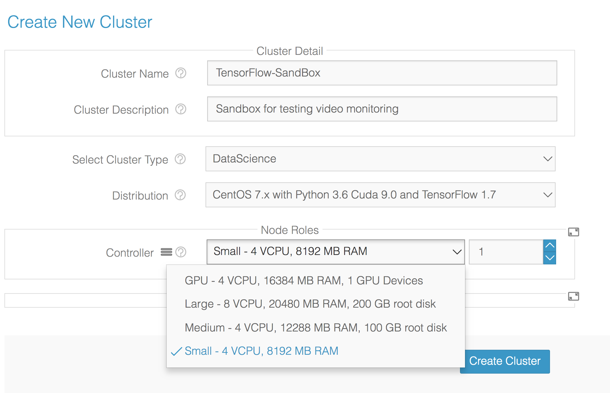
On-Demand Cluster Creation
Pick from a list of
pre-built and tested images
Assign specific resources (GPUs, CPUs) to the cluster, depending on the use case

Slide 40
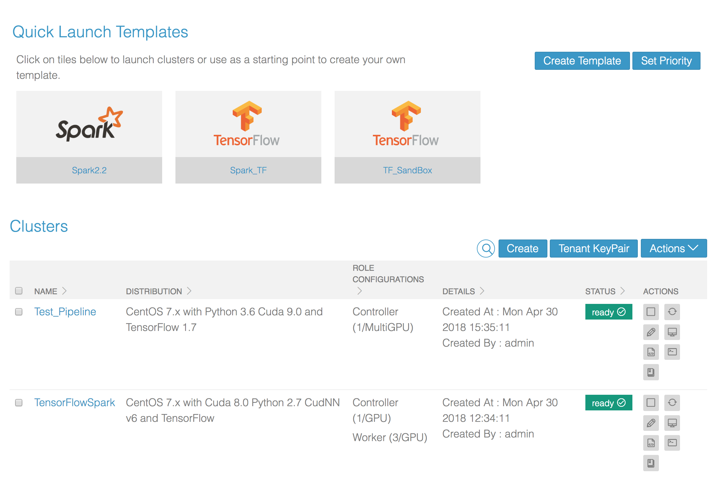
Spin Up Multiple Clusters
Quick launch templates for one click cluster creation
Run multiple clusters, with different versions or combinations of tools, side by side

Slide 41
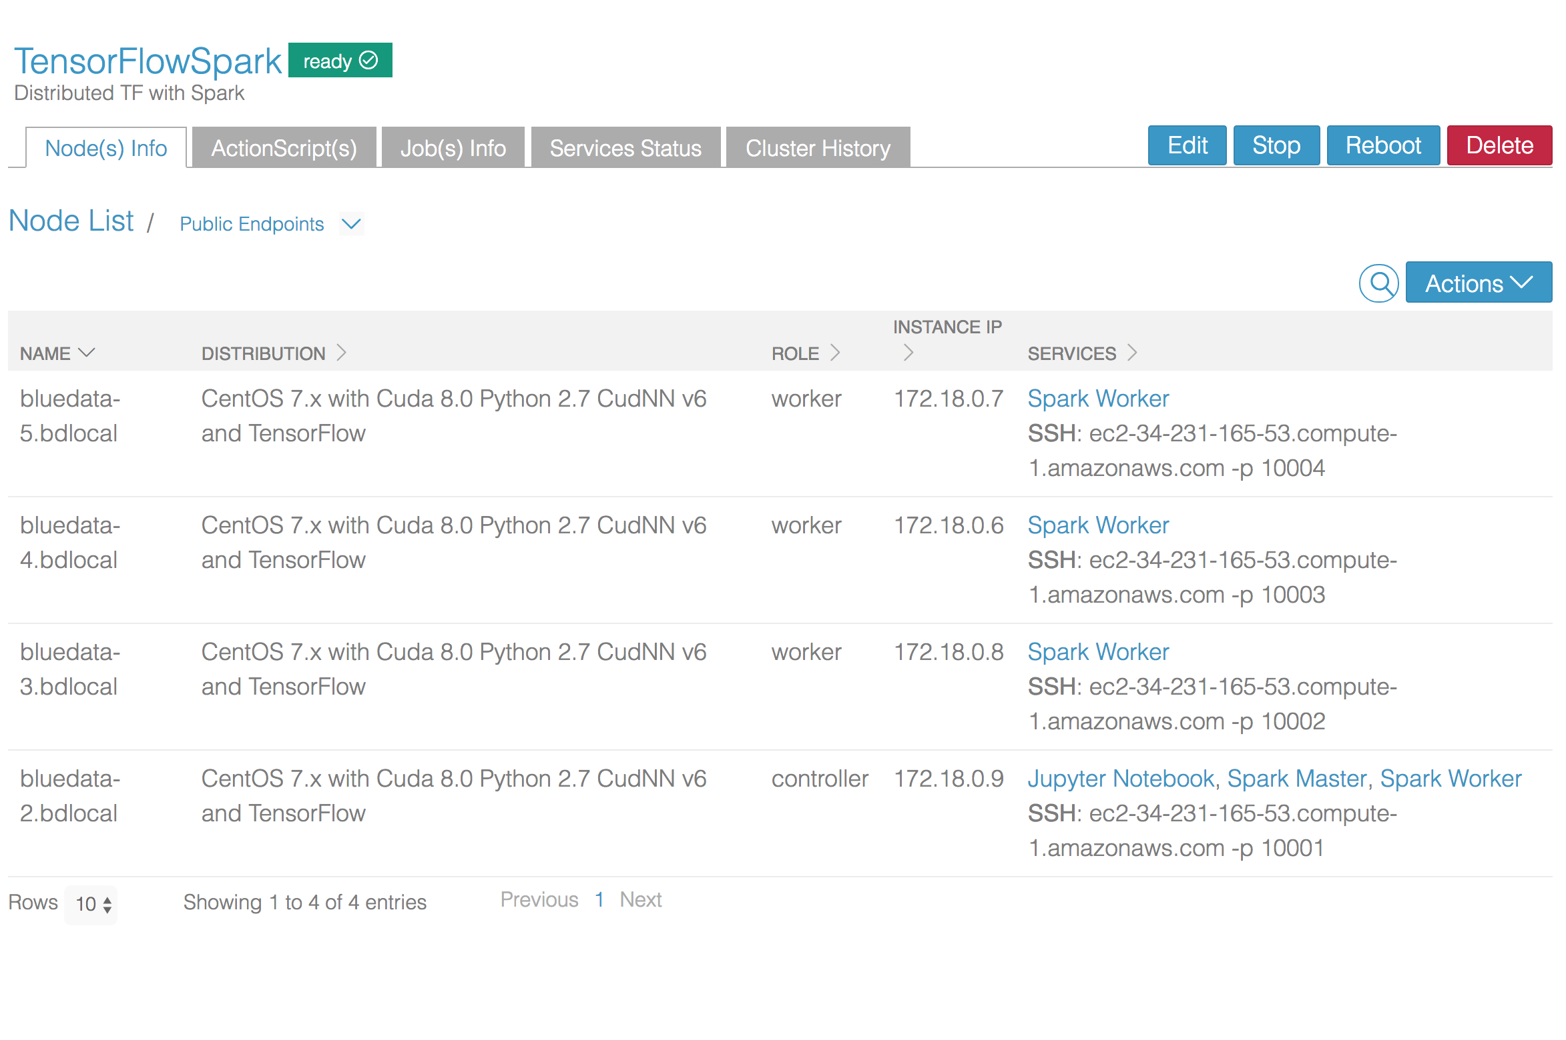
Automated Cluster Provisioning
Out-of-the-box automated creation of multi-node, multi-service clusters
User-friendly links and port mappings to relevant services (e.g. Jupyter notebook)

Slide 42
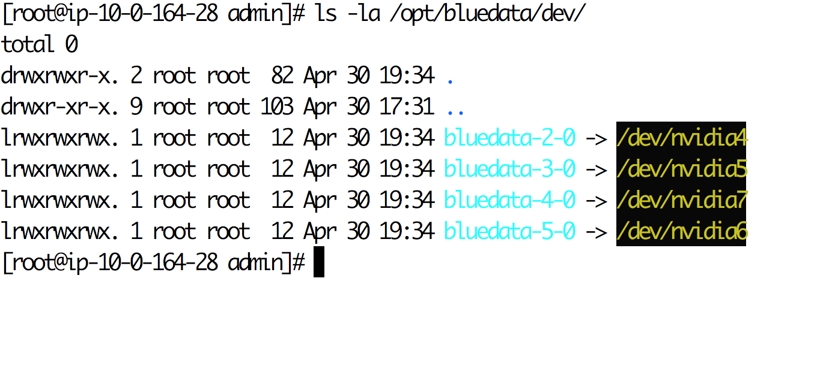
Isolation of GPUs to Containers
Container placement on GPU hosts, based on quota and GPU availability

Slide 43
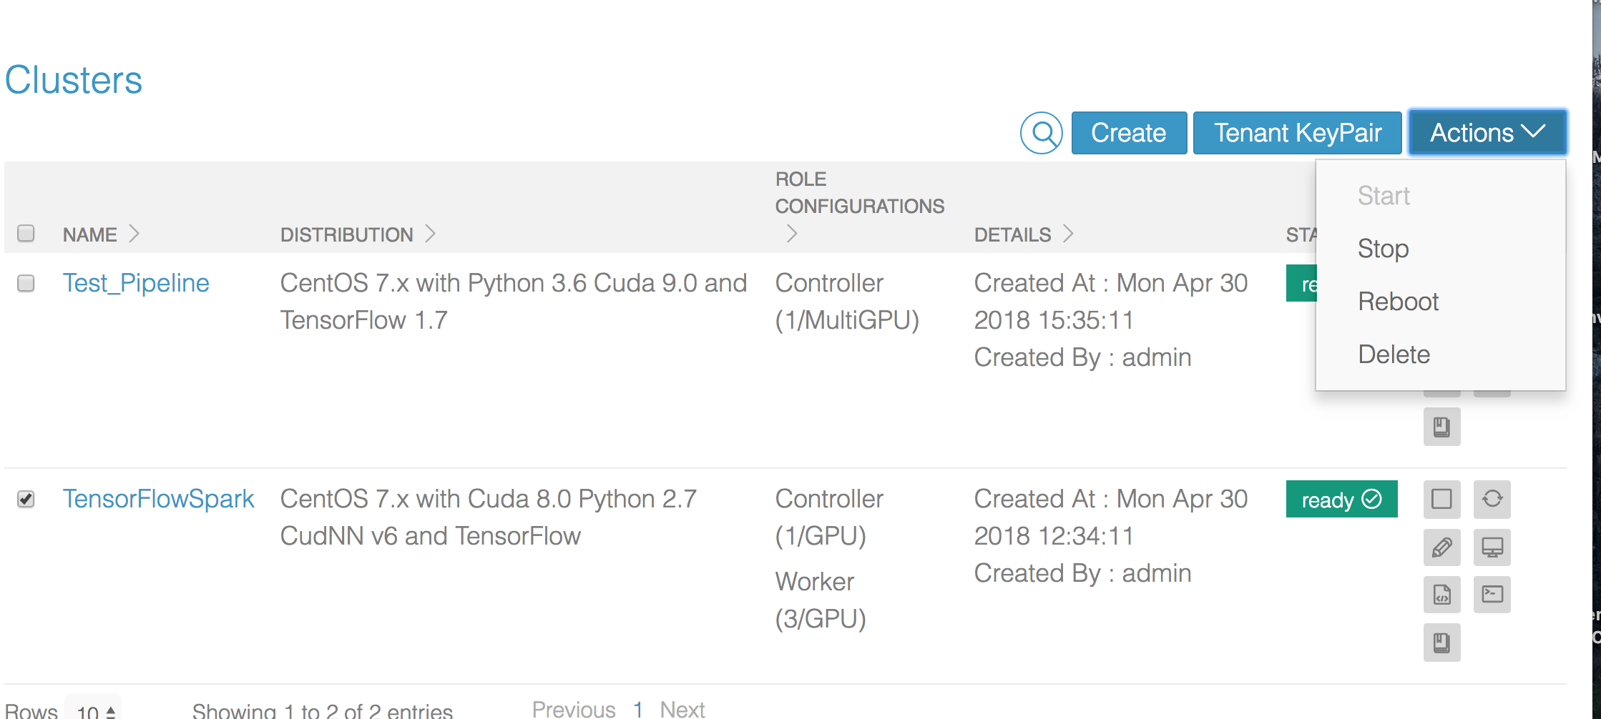
Ability to Release and Attach GPUs
Users can stop clusters to release GPUs and other resources

Slide 44
Distributed Deep Learning on Docker
Secure, multi-tenant, elastic environments on shared infrastructure
Prototype
Support for Parallelism
On-demand GPU-enabled clusters for deep learning
Submit jobs using notebooks, web UI, or API
Web-based SSH access for CLI jobs
Shared storage access with security
Cloud-ready architecture, using Docker containers
Quickly deploy sandbox nodes in minutes
Model save, load, share, and run
Compute Isolation
CUDA runtime
cuDNN
Mount GPU devices and
surface device drivers
Mount GPU devices and surface device drivers
Containerized Big Data Infrastructure
GPU and
Non-GPU Hosts
Data Isolation
Data Isolation
HDFS Data Lake or NFS Enterprise Storage
Notes:
Simple and Efficient
Manage environment with point and click
Minimal admin overhead
Integrated Data Layer
De-coupled data/storage
Multiple clusters can share data & metadata
Cost Effective and Flexible
Up to 70% cost savings
Use multiple tools/distros
Centralized operating model
Single pane of glass to manage multiple environments
Full control over resource optimization

Slide 45
Lessons Learned
Distributed deep learning applications can be deployed on Docker containers
GPU resources can be effectively shared between multiple applications
Deep learning requires a complex software / hardware stack
This complexity can be abstracted from the data scientist with self-service provisioning and automation
For a flexible and scalable solution, data resources should be decoupled from compute resources

Slide 46
Takeaways & Recommendations
Start with a few key use cases to explore deep learning
The only constant is change ... be prepared
Business needs, use cases, and tools will constantly evolve
Leverage a flexible, scalable, and elastic platform for success
Containerization can deliver agility and cost saving benefits
But there are significant challenges ... DIY will likely be DOA
BlueData provides a turn-key containerized platform for Big Data analytics and ML / DL applications

Slide 47
Tom Phelan
Nanda Vijaydev
@tapbluedata
@nandavijaydev
www.bluedata.com
Visit BlueData Booth #211
in Strata Expo Hall
Notes:
…

